Slide 1
Windows Tech Series Windows 10 Enterprise E3 in CSP Overview of CSP Program
Speaker 1
Title
Speaker 2
Title

Slide 2
Agenda
Day | Day 1 Deployment | Day 2 Management | Day 3 Security | Day 4 Windows for CSP
 |  |  |  | Deployment | Management | Security
Synopsis | Module 1 – Introduction | Module 1 – Base System Setup | Module 1 – Analysis Of Common Threats | Module 1 – Subscription
 | Module 2 – Applications & Updates | Module 2 – Configuration | Module 2 – Hardening Windows | Module 2 – Deployment
 | Module 3 – Windows as a Service (WaaS) | Module 3 – Managing Client Devices | Module 3 – Advanced Threat Protection | Module 3 – Management
 | Module 4 – Browsers & Internet Security | Module 4 – Advanced management options I | Module 4 – Information Security (WIP/AIP) | Module 4 – Security
 | Module 5 – Secure Boot & Device Guard | Module 5 - Advanced management options II | Module 5 – Internet Security

Slide 3
What is CSP?
A licensing model and program
An annuity stream
A way for the partner to own the lifecycle
Any type of partner can sign up for CSP at aka.ms/csp

Slide 4





How important is CSP?
Microsoft mission
Empower every person and every organization on the planet to achieve more
Mobile-first
Cloud-first

Slide 5

What is the CSP business model?
CSP puts the partner in charge of the customer relationship including support and billing
Customer
Some partners will build their own infrastructure to take on customer support and invoicing, and act as a Direct Partner
Most partners will act as Indirect Resellers, collaborating with an Indirect Provider to meet customer needs
Direct Partner
Indirect Provider
Indirect Reseller
Microsoft Online Services
Microsoft will provide Cloud Services, while partners will add on their own Managed Services and IP

Slide 6



What margins and incentives are available?
partnerincentives.microsoft.com
Direct Partner Margins
Azure = 15%
Office 365 = 20%
Dynamics = 25%
Incentives Requirements
Active MPN ID & Signed Agreement
Managed Partner List
Onboard to Incentives Payment Tool (PIEX)
8% for Direct Partners & Indirect Resellers
Local Incentives May Be Available

Slide 7



Do I have to provide support?
You are responsible for your customers being supported, but you don’t have to provide support yourself

Slide 8
What support is available to me?
Account management
Service delivery
Deployments covered
Problem resolution
Assigned
On-site and remote
Cloud
Hybrid
On-premises
Fastest response
First priority, 1/2/4 SLA CritSit
Premier support for Partners
BEST
Pooled
Remote
Cloud
Limited hybrid
Faster response
Second priority, 1/2/4/SLA
Advanced support for Partners
BETTER
N/A
Remote
Cloud
Hybrid
On-premises
Standard response
Third priority, 2/4/8 SLA
MPN technical Services
GOOD
aka.ms/partnersupportofferings

Slide 9

Who owns CSP in the Microsoft field?
EPG
SMS&P
PSE
PB&D
Dynamics
Public Sector
HSP
Everybody does

Slide 10

Which is better? CSP, EA, or MPSA
CSP Sweetspots
Strong partner value add
Customer in state of flux
Smaller customers
Workloads across the enterprise
May drive thousands of seats
Office 365/CRM/AX embedded
Mergers and acquisitions
Partner becomes the IT department
Move everything to the cloud
Vertical app with Azure embed
Single tenant ISVs

Slide 11







What services are available?
Enterprise Mobility Suite
Power BI

Slide 12

Are there any offers for education?
Partner value-add services
Office 365 EDU
Office 365 ProPlus
Office 365 EDU E5
AAD, RMS, EMS, Intune
CRMOL EDU
Azure metered services¹
www.mepn.com
¹All usage based Azure metered services are available for partners, but there’s no additional discounted pricing for Education

Slide 13




What are the keys to CSP success?
Differentiate to stand out
Modernize sales and marketing
Optimize your operations
Deliver customer lifetime value
aka.ms/modernpartner

Slide 14


What can I do with Azure?
Use Azure to extend
your customers’ datacenter
Use Azure to build new, cloud applications
Run Custom applications within Virtual Machines
Offer Disaster Recovery to your customers
Run and Manage Databases
Lift and Shift N-Tier Apps (Windows or Linux)
Web & Mobile Apps
Machine Learning and IOT Solutions
Big Data Solutions
Backup On-premises Workloads
Offer Desktop-as-a-Service

Slide 15

What complementary services are available?
Platform operations
Help desk solutions
API integration
Migration automation
Billing systems
Onboarding
Cloud marketplace
ISV applications
Support services

Slide 16
Can I sell across country borders?
Single Country Regions
APAC
LATAM
Africa
EU
ME/CEE
Taiwan
Korea
Japan
India
New Zealand
United States
Canada
Russia
Brazil
Australia/Fiji
Bangladesh
Brunei Darussalam
Hong Kong SAR
Inonesia
Malaysia
Philippines
Singapore
Thailand
Vietnam
Macao SAR
Argentina | Guatemala
Bahamas | Honduras
Barbados | Jamaica
Belize | Mexico
Bermuda | Nicaragua
Bolivia | Panama
Cayman Islands | Paraguay
Chile | Peru
Colombia | Puerto Rico
Costa Rica | Saint Kitts and Nevis
Curacao | Trinidad and Tobago
Dominican Republic | Uruguay
Ecuador | Venezuela
El Salvador | Virgin Islands
Angola
Botswana
Cameroon
Cabo Verde
Côte d'Ivoire
Ethiopia
Ghana
Kenya
Mauritius
Namibia
Nigeria
Rwanda
Senegal
Tanzania
Uganda
Zambia
Austria | Liechtenstein
Belgium | Lithuania
Bulgaria | Luxembourg
Croatia | Malta
Cyprus | Monaco
Czech Republic | Netherlands
Denmark | Norway
Estonia | Poland
Finland | Portugal
France | Romania
Germany | Slovakia
Greece | Slovenia
Hungary | Spain
Iceland | Sweden
Ireland | Switzerland
Italy | UK
Latvia | Faroe Islands
Afghanistan | Montenegro
Albania | Morocco
Algeria | Nepal
Armenia | Oman
Azerbaijan | Pakistan
Bahrain | Palestinian Authority
Belarus | Qatar
Bosnia & Herzegovina | Serbia
Egypt | Sri Lanka
Georgia | Tajikistan
Iraq | Tunisia
Israel | Turkmenistan
Jordan | Ukraine
Kazakhstan | United Arab Emirates
Kuwait | Uzbekistan
Kyrgyzstan | Saudi Arabia
Lebanon | South Africa
Libya | Turkey
Macedonia (FYROM) | Yemen
Moldovia | Zimbabwe
Mongolia

Slide 17

VAR
Consultant
Hoster
SMB
IOT
CRM
Start up
Does my company fit?
ERP
OEM
Large
ISV
Small
Born in the cloud
SI
App Dev

Slide 18
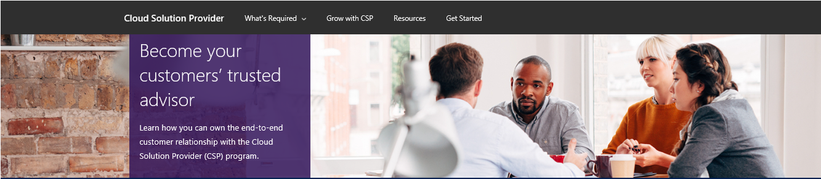
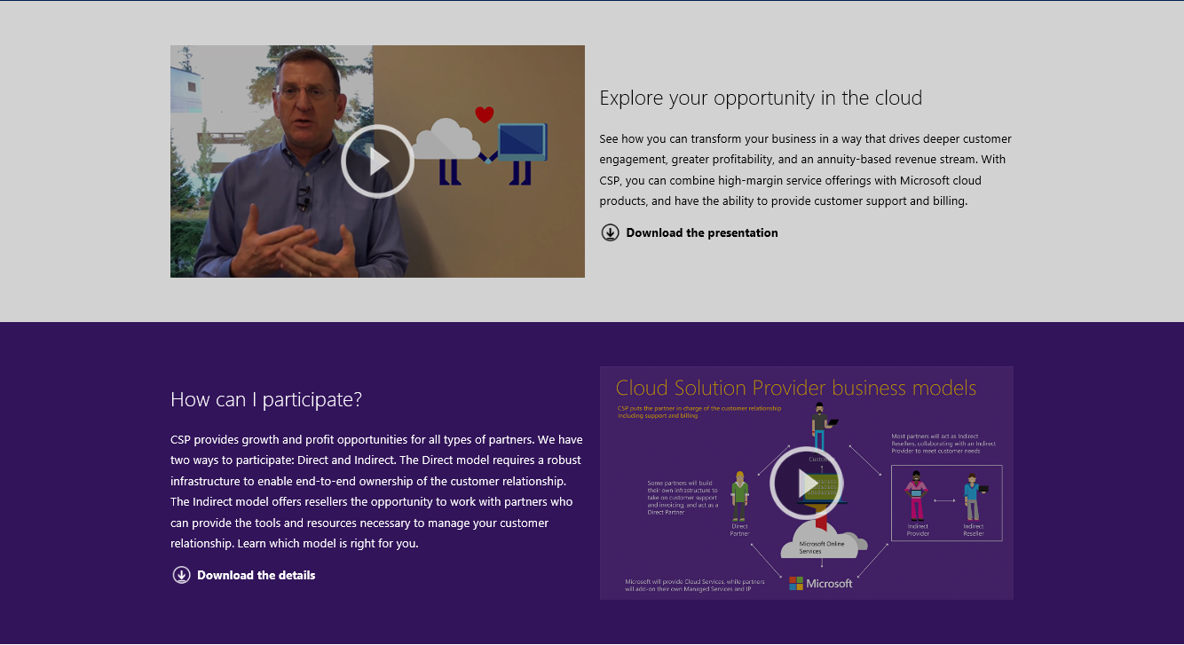
How do I sign up?
aka.ms/csp

Slide 19

When should I start?
aka.ms/csp

